Slide 1



Power BI – Project: Adventure Works Author: Giuliano Fischetto
Project built for the Udemy Course “Microsoft Power BI Desktop for Business Intelligence” completed on 03/10/2024
Course certificate Link: Udemy Course Completion Certificate | Udemy
Contact: fischetto_eet2@hotmail.com | Giuliano Fischetto | LinkedIn

Slide 2
Resume
This presentation showcases a project built using Microsoft Power BI, demonstrating my proficiency in data manipulation, modeling, analysis, and visualization.
Key Learnings Explored:
Connecting and Shaping Data: Explored the process of importing CSV data, cleaning, and transforming it for optimal analysis.
Creating a Data Model: Learned how to establish relationships between tables, ensuring data consistency and facilitating comprehensive insights.
Calculated Fields with DAX: Discovered the power of DAX expressions to create custom calculations, extending the reach of your data analysis.
Visualizing Data with Reports: Uncovered techniques for building interactive dashboards with compelling charts and graphs, effectively communicating key findings.

Slide 3
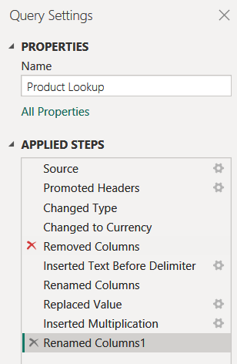
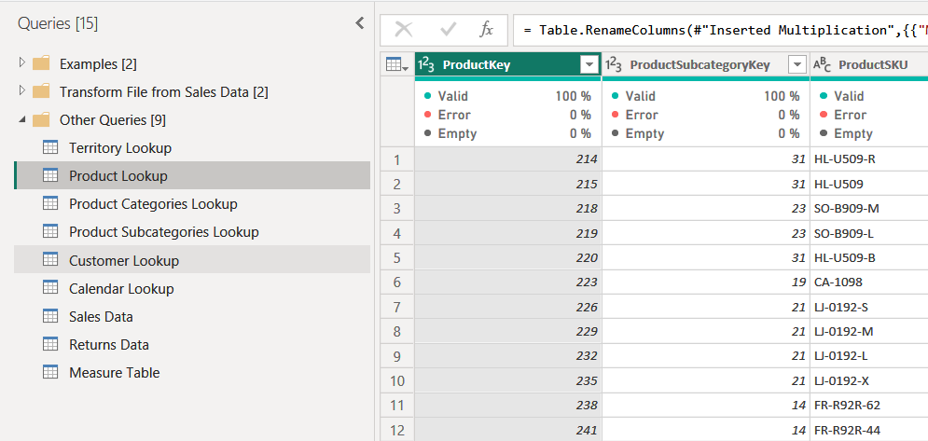
1. Connecting and Shaping Data
Power BI's Power Query Editor was used to transform raw data into a clean and analysis-ready format.
Importing the Data: CSV files were connected using the Power Query Editor. A data preview allowed for a quick inspection.
Data Transformation: Applied Steps: This section chronologically lists all the transformations applied to the data.

Slide 4
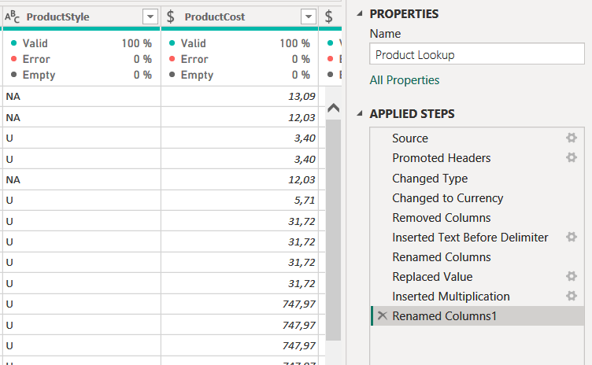
1. Connecting and Shaping Data
Data Cleaning with Column Quality:
Power Query Editor's Column Quality view helped identify:
Valid Values: Clean data ready for analysis (green bullet).
Errors: Inconsistent or incorrectly formatted data (red bullet).
Empty Values: Missing data points (purple bullet).
Some used techniques to address these issues, where:
Converting data types (e.g., text to numbers).
Filling missing values with appropriate methods (e.g., averages or custom values).
Removing rows with critical errors.

Slide 5
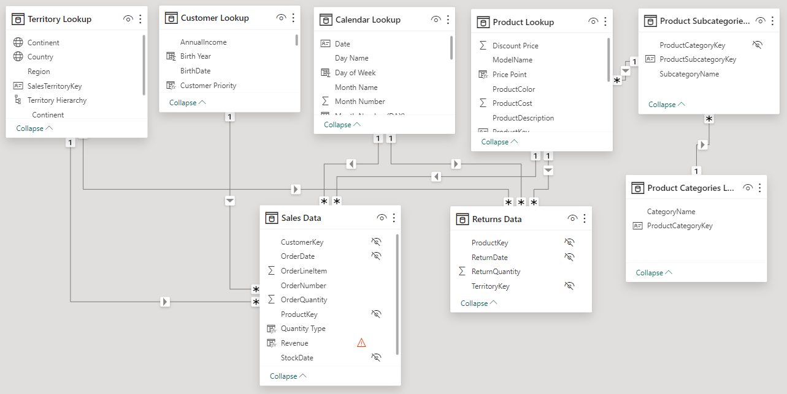
2. Creating a Data Model
Fact vs. Dimension Tables:
Fact Tables (Sales & Returns): Store quantitative data
Dimension Tables (Territory, Product, Customer, Calendar): Provide context

Slide 6
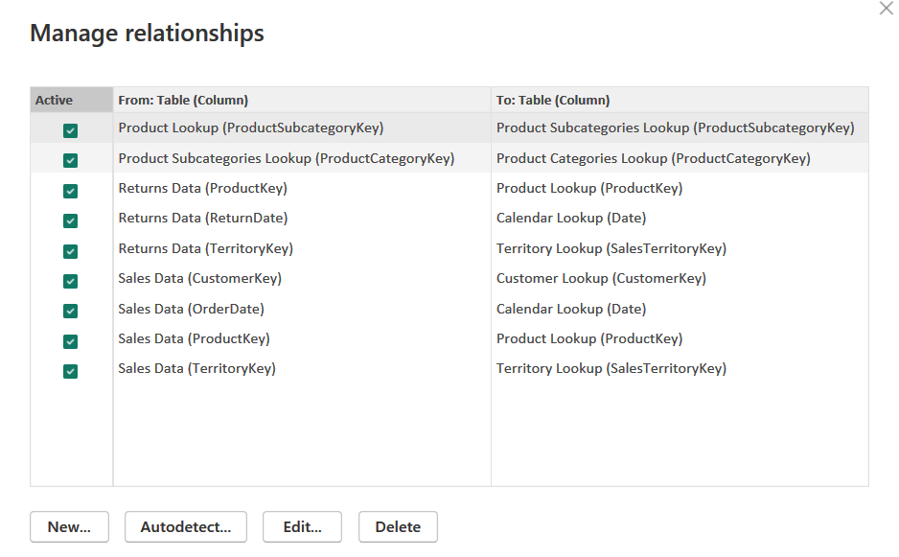
2. Creating a Data Model
Relationships Defined: In the Relationships window tables were linked based on shared fields (e.g., Sales table to Customer table via "CustomerKey").
Cardinalities Set: Cardinalities (one-to-one, one-to-many, many-to-many) defined how filtering affects related data.

Slide 7
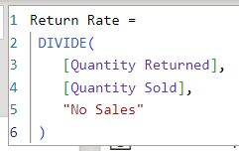
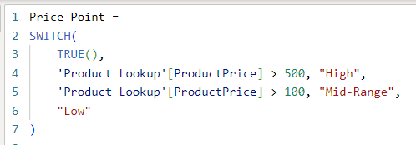
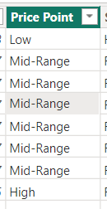
3. Calculated Fields with DAX
The Data Model laid the groundwork, but DAX formulas unlocked deeper insights by extending the capabilities of our analysis.
Why DAX? No modification of CSV files?
DAX preserves the original data. Modifying CSVs can be cumbersome and risk data integrity.
DAX calculations are optimized for Power BI, leading to faster analysis compared to manipulating vast amounts of data within CSVs.
Sharing the Power BI report with DAX calculations allows for broader collaboration without modifying the original data source.
DAX in Action:
Measures: These are DAX formulas specifically designed to summarize data across entire tables or rows. They're ideal for displaying key performance indicators (KPIs) in visualizations.
Example: a “Return Rate” Measure was calculated by dividing [Quantity Returned] by [Quantity Sold] (these last were previously calculate measures)
Calculated Columns: These DAX formulas create new data points within existing columns, adding context or transforming data.
Example: a “Price Point” Calculated Column was created for categorizing product by their value

Slide 8
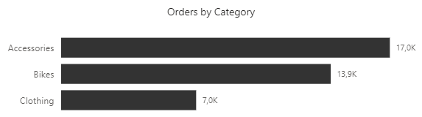
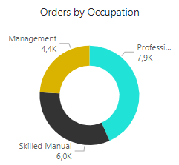
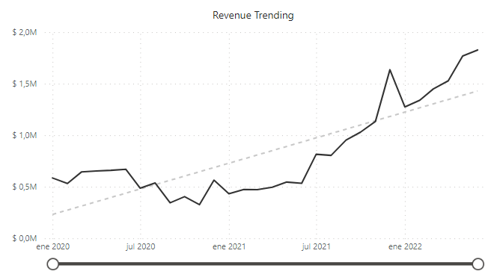
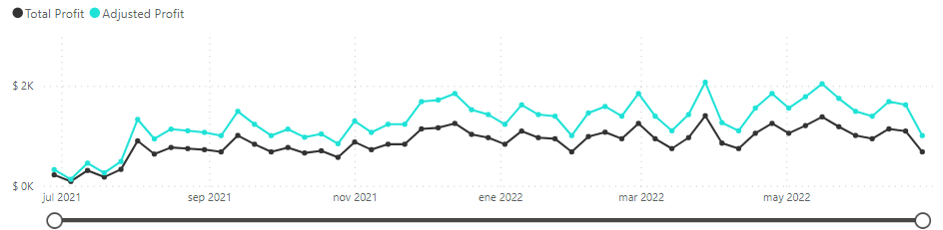
4. Visualizing Data with Reports
With a rock-solid Data Model and DAX calculations empowering the analysis, the exciting stage arrived: creating impactful visualizations in Power BI reports.
Choosing the Right Chart:
Various chart types where explored to best represent the data and uncover trends.
Common choices may include:
Bar Charts: Ideal for comparing categories
Line Charts: Excellent for visualizing trends and continuous data.
Donut Charts: Useful for depicting proportions of a whole.
Scatter Plots: Effective for revealing relationships between two numerical variables.

Slide 9
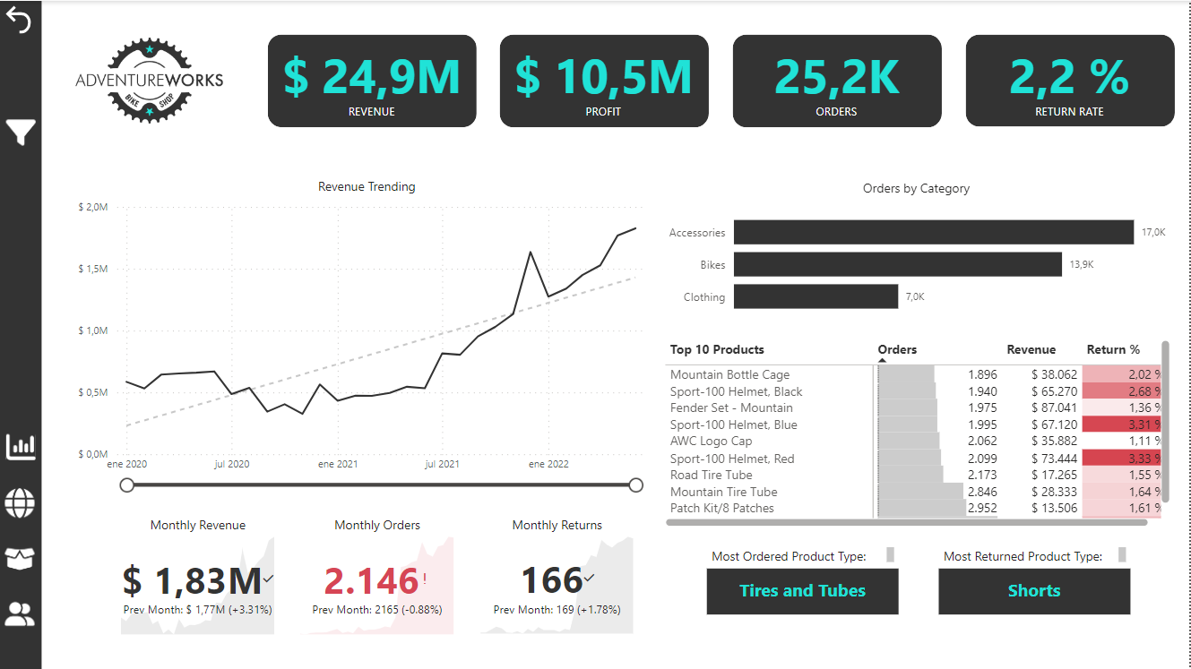
4. Visualizing Data with Reports
Interactive Visualizations:
We incorporated interactive elements to allow users to explore the data further.
Examples include:
Slicers and Filters: Users can filter data by specific dimensions e.g. below: product category = Bikes, time period May2021-Dec2021

Slide 10
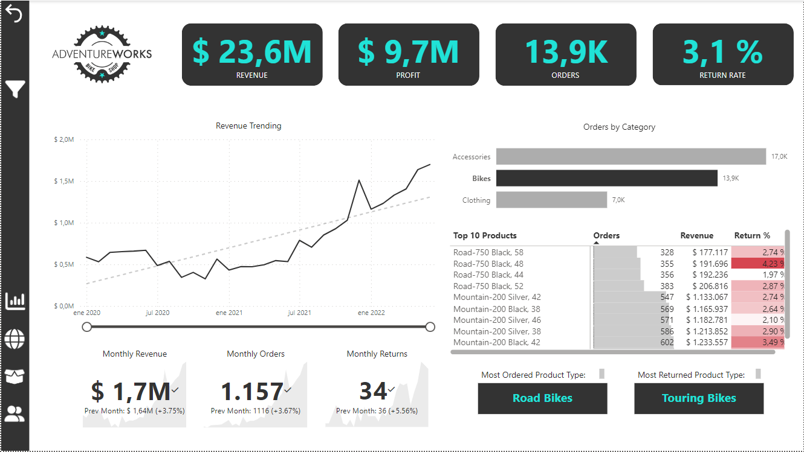
4. Visualizing Data with Reports
Interactive Visualizations:
We incorporated interactive elements to allow users to explore the data further.
Examples include:
Slicers and Filters: Users can filter data by specific dimensions e.g. below: product category = Bikes, time period May2021-Dec2021
! Note how the other cards and table also change when a slicer and/or filter is selected

Slide 11

4. Visualizing Data with Reports
Interactive Visualizations:
We incorporated interactive elements to allow users to explore the data further.
Examples include:
Slicers and Filters: Users can filter data by specific dimensions e.g. below: product category = Bikes, time period May2021-Dec2021
! Note how the other cards and table also change when a slicer and/or filter is selected

Slide 12
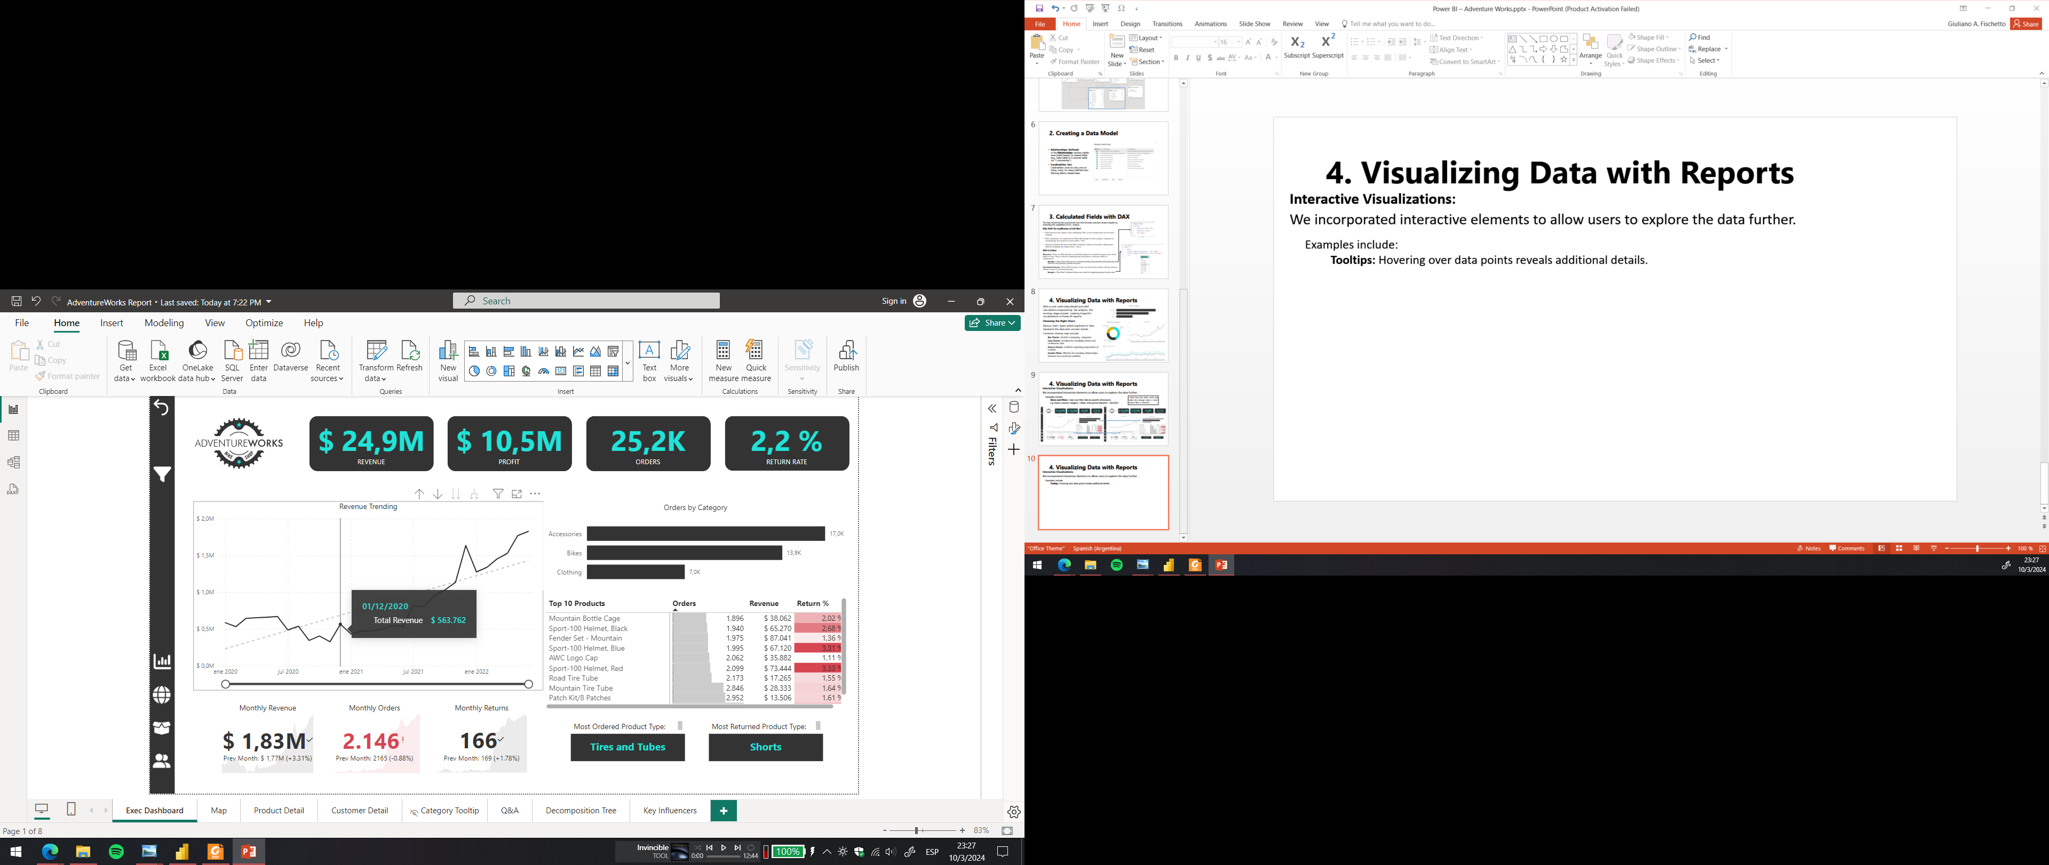
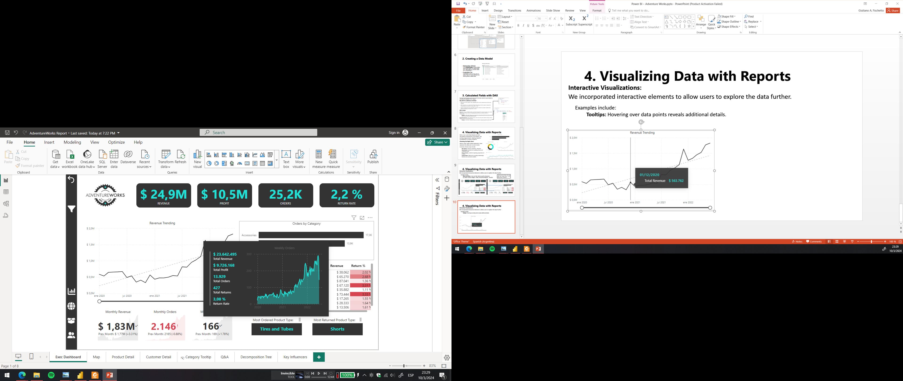
4. Visualizing Data with Reports
Interactive Visualizations:
We incorporated interactive elements to allow users to explore the data further.
Examples include:
Tooltips: Hovering over data points reveals additional details.

Slide 13
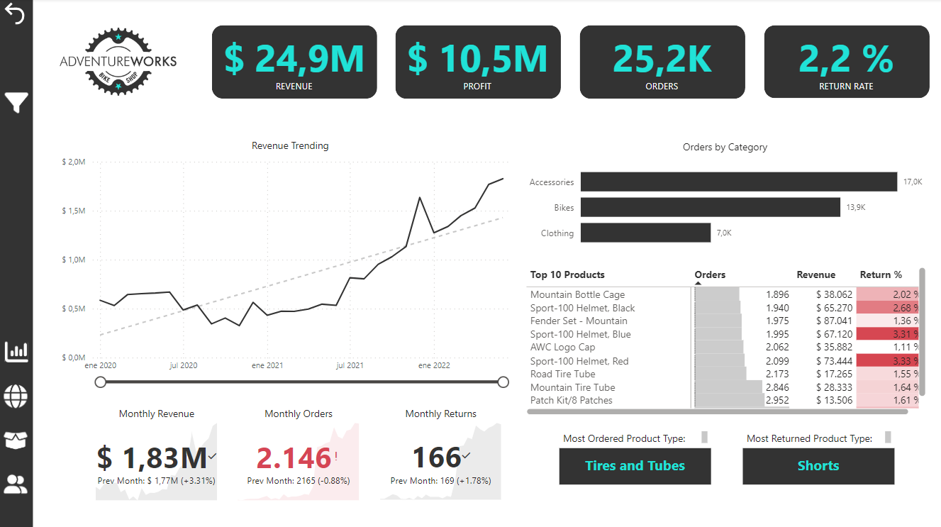
The four final dashboards
1. Executive Dashboard: This dashboard displays key performance indicators (KPIs) for executives and managers, including total revenue, profit, returns, and trends over time. Monthly results, revenue by product category, top-ordered products, and top-returned products are also visualized.

Slide 14
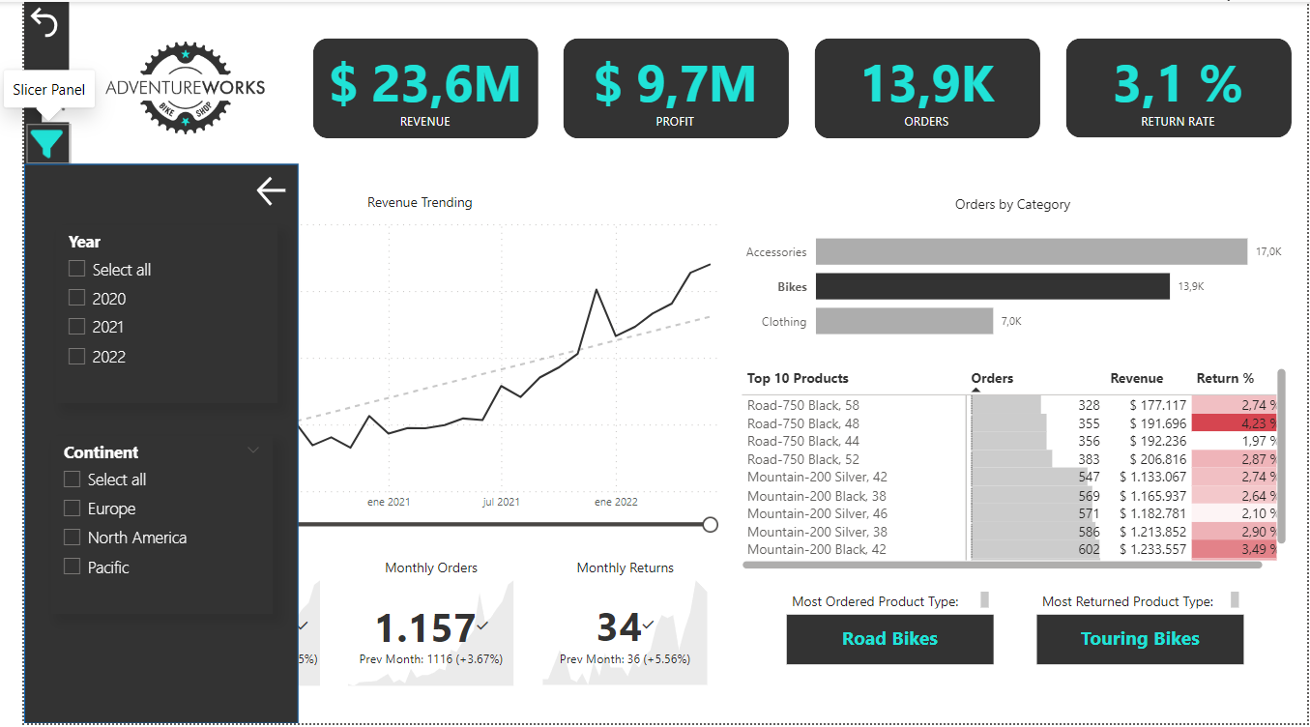
The four final dashboards
1. Executive Dashboard: This dashboard displays key performance indicators (KPIs) for executives and managers, including total revenue, profit, returns, and trends over time. Monthly results, revenue by product category, top-ordered products, and top-returned products are also visualized.
! Note: we can add buttons that can open new panels for more filtering options

Slide 15
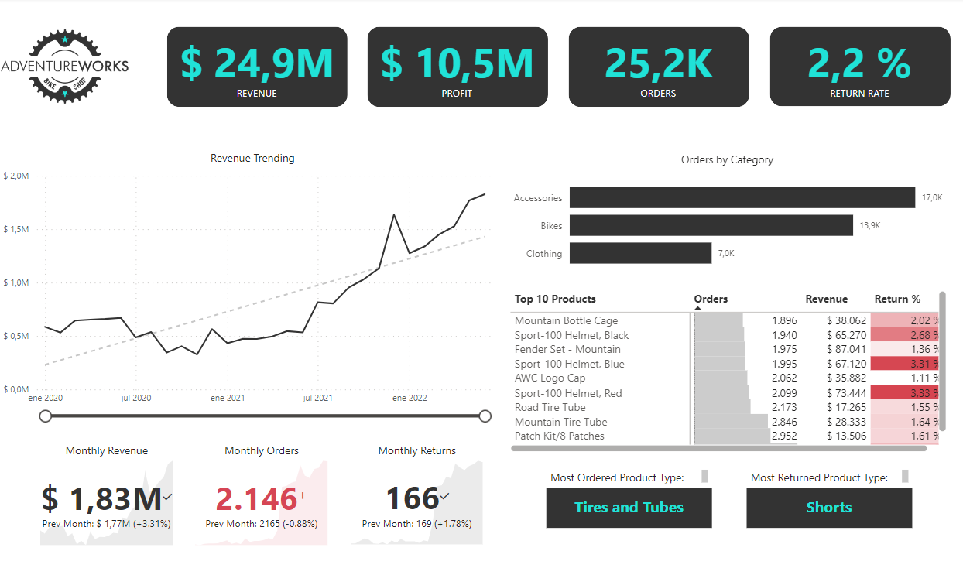
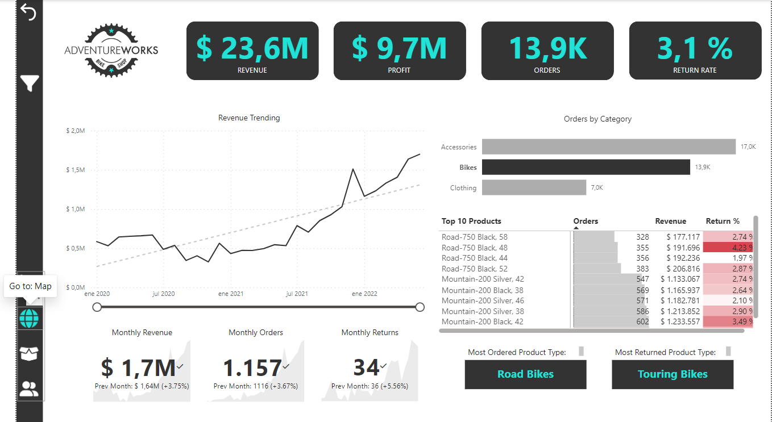
The four final dashboards
1. Executive Dashboard: This dashboard displays key performance indicators (KPIs) for executives and managers, including total revenue, profit, returns, and trends over time. Monthly results, revenue by product category, top-ordered products, and top-returned products are also visualized.
! From here we can navigate to the next panel: Map

Slide 16
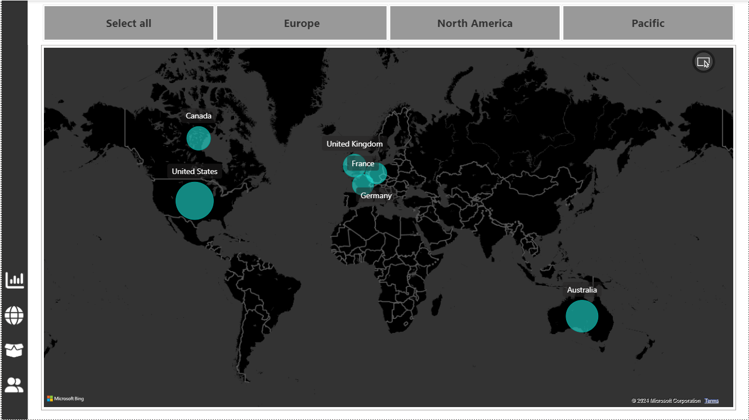
The four final dashboards
2. Map: This map visualizes geographical sales data. Bubble size represents the number of orders sold in each country. A Tile slicer at the top allows filtering by region.

Slide 17
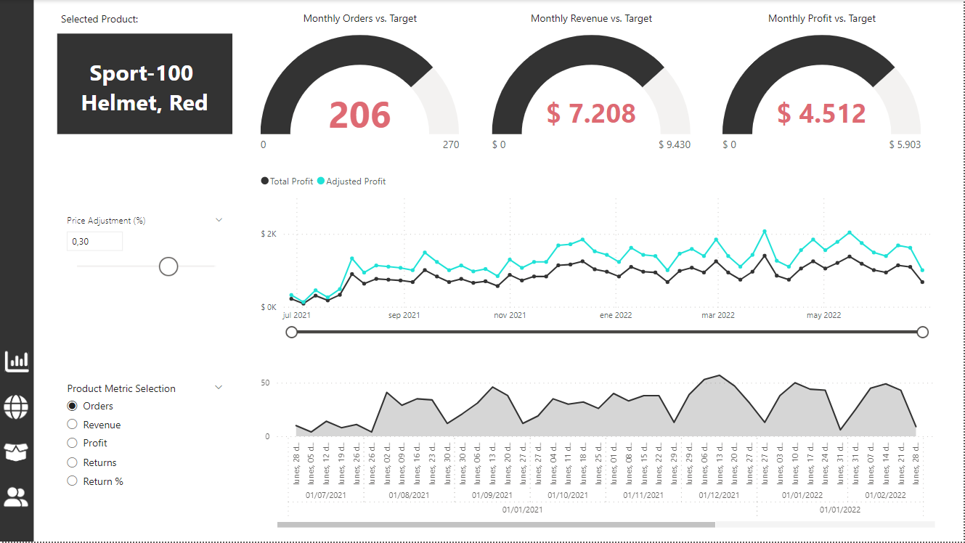
The four final dashboards
3. Product Detail: Accessible by selecting a product on the Executive Dashboard through drill-through functionality, this dashboard provides detailed product-specific results. Users can leverage various slicers and filters for further analysis. Additionally, line charts offer drill-up and drill-down capabilities to view aggregated data by year, month, week, etc.

Slide 18
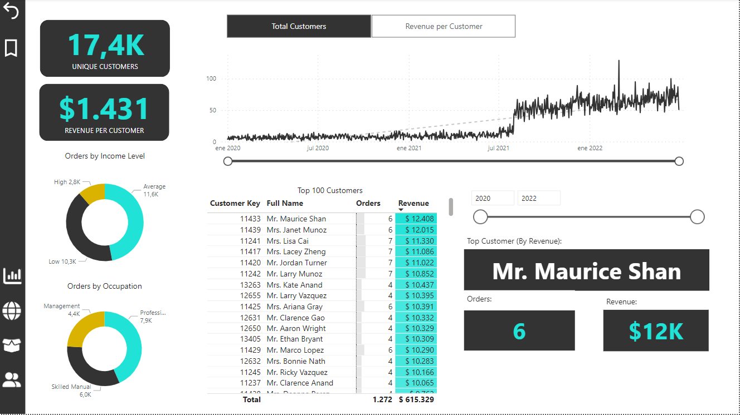
The four final dashboards
4. Customer Detail: Mirroring the format of the Product Detail dashboard, this section focuses on customer-centric insights.

Slide 19
The four final dashboards

Slide 20
Overall Dashboards results
Designed a suite of interactive Power BI dashboards for executives, managers, and analysts.
Presented key performance indicators (KPIs) including total revenue, profit, and trends for informed decision-making.
Visualized geographical sales data and enabled regional filtering for targeted analysis.
Empowered users to drill down into product and customer details through interactive features.
Facilitated exploration of data with slicers, filters, drill-through and drill-up/down functionalities for line charts.

Slide 21
Overall Project and Course results
Successfully completed a data analysis project utilizing Power BI and DAX expressions.
Transformed raw data into a well-structured Data Model for optimal analysis.
Created custom calculations using DAX to unlock deeper insights from the data.
Developed visually compelling and interactive dashboards to communicate complex information effectively.
Demonstrated proficiency in data visualization best practices and user-centric design principles.

Slide 22
Thanks for your time!
Contact me: fischetto_eet2@hotmail.com | Giuliano Fischetto | LinkedIn

